Slide 1
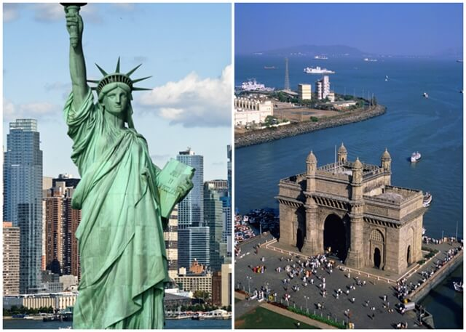
Relocating from Mumbai to New York
Indian students search for neighborhood with Indian Grocery Store and Indian Restaurant
Notes:
Picture source : https://www.indianeagle.com/travelbeats/air-india-nonstop-new-york-jfk-mumbai-flights/

Slide 2
Problem Statement
An Indian student is moving to New York from Mumbai for further studies. As he will use public transportation system for daily commute and will hardly have any time for cooking. Ideally, he wants to live in a neighborhood with both Indian grocery store and Indian restaurant, if not, at least one of them.

Slide 3
Data Libraries
Data Source: New York is pulled from shared drive provided in IBM Coursera program lab.
Libraries - Foursquare API, Pandas, NumPy, JSON, Geopy, Requests, Matplotlib, Python Plotting Module, Sklearn, Folium

Slide 4
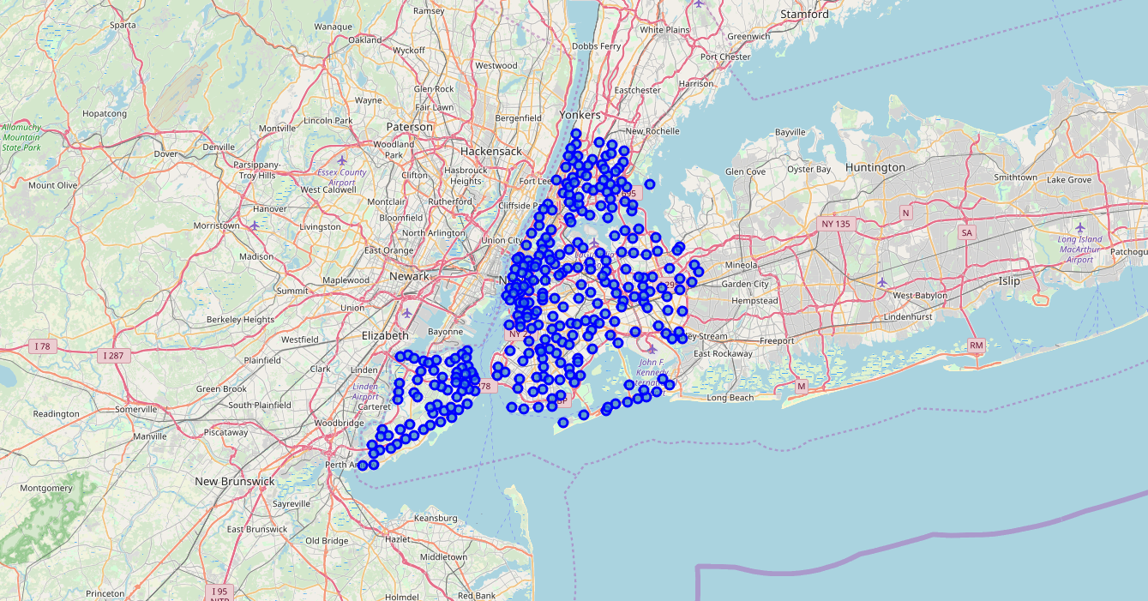
New York Neighborhoods
There are 5 borough and 306 neighborhoods in New York City

Slide 5
Number of Venues and Categories
Number of venues in 306 neighborhoods in New York City 30362
Categories of venues 442

Slide 6
Categories
We are focused on two categories of venues - Grocery Store and Indian Restaurant

Slide 7
Neighborhoods with Indian Restaurants and Indian Grocery Store
Queens in Queen Borough has Indian Grocery Store name “Sri Siddivinayak Grocery Store” and Indian Restaurant named “Ayna Agra Indian Restaurant”

